Slide 1
ITAI 3377 | CAPSTONE PROJECT
Autonomous Maintenance
Agent for a Smart Factory
A Conceptual AI-Driven Design for Predictive
Maintenance in Industrial Edge Environments
Judith Barrios | Conceptual Path | Due: April 29

Slide 2
OVERVIEW
Project Proposal & Scope
The Problem
The Solution
Key Goals
Factories lose huge amounts of money when machines break down without warning. Fixed maintenance schedules do not reflect actual equipment condition, leading to wasted resources and missed issues.
An autonomous AI agent monitors live sensor data around the clock and takes action on its own, catching warning signs before a failure occurs instead of reacting after the fact.
Fewer unplanned shutdowns, lower repair costs, smarter use of maintenance staff time, and a safer environment for factory workers across the operation.
2 / 8

Slide 3
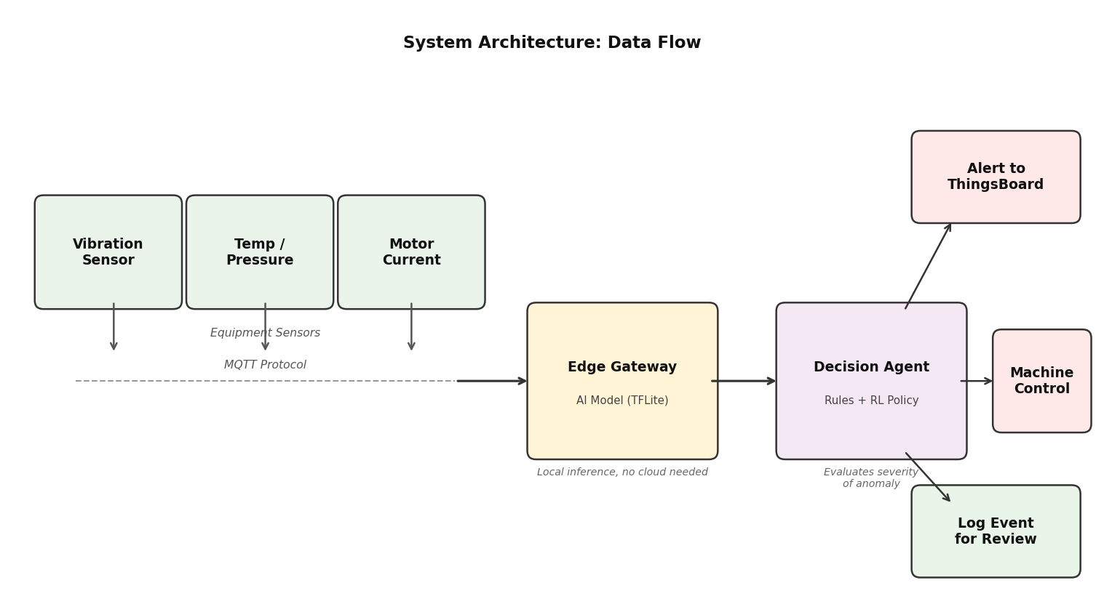
ARCHITECTURE
System Architecture
Edge-First Design
Sensors stream readings over MQTT to a local edge gateway, keeping all time-sensitive decisions close to the equipment.
Communication Protocols
MQTT handles sensor-to-edge traffic. HTTP/REST connects the edge to the ThingsBoard cloud dashboard for reporting.
Cloud Role
The cloud handles long-term trend tracking and manager reporting only — not real-time calls.
3 / 8

Slide 4
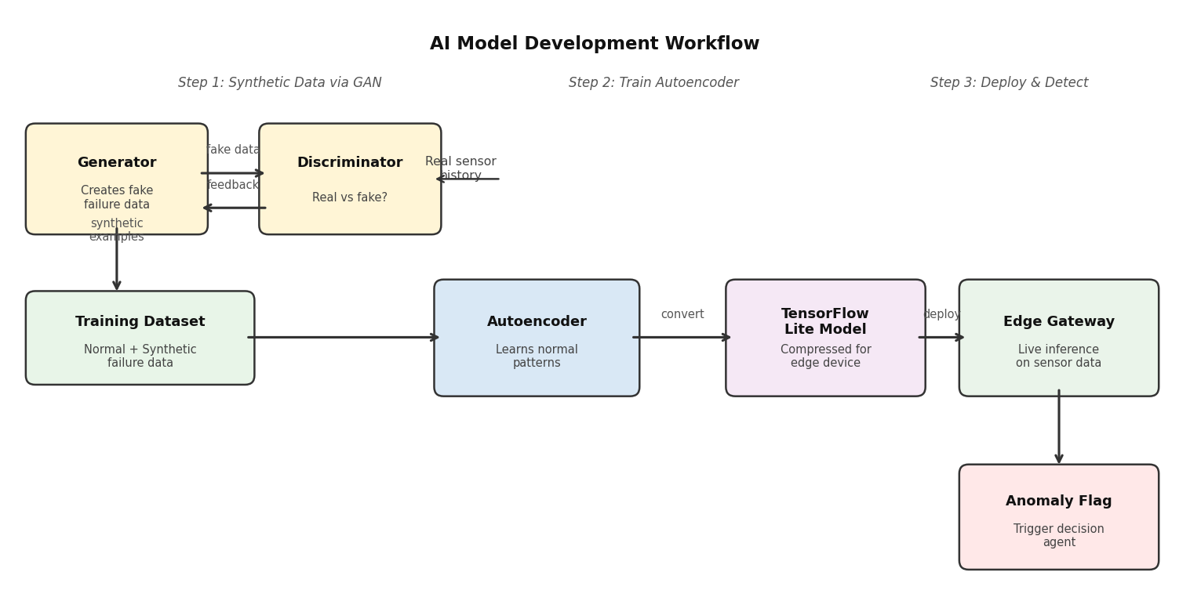
AI MODEL
AI Model Development
Autoencoder
GAN
Decision Agent
Learns normal patterns, flags deviations. Runs on TensorFlow Lite for fast edge inference.
Generates synthetic pre-failure sensor data to fill gaps left by rare real failure events.
Combines rule-based triggers with a reinforcement learning policy for smarter responses over time.
4 / 8

Slide 5
SECURITY & ETHICS
Security & Ethical Considerations
Security Measures
Ethical Risks
TLS encryption on all communication channels between sensors, edge, and cloud.
Device certificates so only verified hardware can send data through.
Role-based dashboard access — each user sees only what their role allows.
Network traffic monitoring for unusual activity on top of standard login checks.
False Positives:
Sending a technician to a machine that is fine wastes time and disrupts production.
False Negatives:
Missing a real warning leads to a failure that could have been prevented.
Training Bias:
GAN data may only cover narrow failure types, creating blind spots. Regular retraining on real data reduces this.
Transparency: Alerts must show reasoning so staff can judge how much to rely on them.
5 / 8

Slide 6
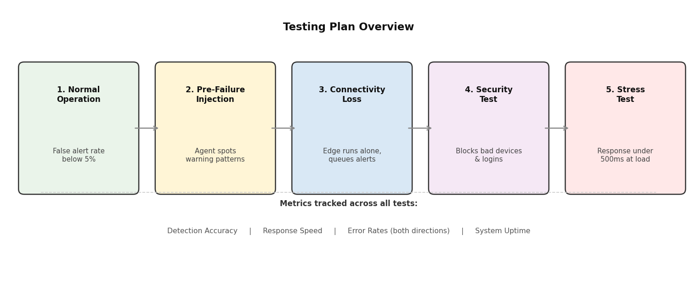
TESTING
Implementation & Testing Plan
If Built Out — Deployment Steps:
1. Train GAN in Google Colab on normal and near-failure sensor data.
2. Export autoencoder as a TensorFlow Lite model for the edge device.
3. Set up Node-RED on the gateway for the full MQTT data pipeline.
4. Connect to ThingsBoard, configure alert thresholds and staff notifications.
6 / 8

Slide 7
REFLECTION
Challenges, Trade-offs & Lessons Learned
01
Synthetic Data Dependency
The GAN fills in for missing real failure data but risks teaching the agent patterns that do not match how equipment actually breaks down. The system has to keep improving as real data builds up over time.
02
Edge vs. Cloud Balance
Putting more on the edge makes things faster but the device has limited power. Keeping the deployed model lean and sending heavier retraining tasks to the cloud is the most practical balance.
03
Planning for Failure
The most valuable part of this design process was thinking through what happens when things go wrong — model drift, sensor outages, alert fatigue — not just designing for when everything works perfectly.
7 / 8

Slide 8
Thank You
Key Takeaways
Edge-first architecture keeps decisions fast and independent of cloud connectivity.
A GAN provides the synthetic failure data needed to train the detection model.
Security and transparency are built into the design from the start, not added after.
Planning for what goes wrong matters more than choosing the right tools.
Judith Barrios | ITAI 3377 | April 2026

